Slide 1
Single Station Location Algorithm for HF DF using Azimuth Bearing, Elevation Bearing and Ionospheric Model Software
Technology Category : COMINT
Thrust Area : Electronic Warfare
Team Members:
Divyesh S P (192424147)
Gnana Surya P(192412235)

Slide 2
Problem Statement
Geolocating distant HF transmitters is challenging due to ionospheric (skywave) propagation.
Conventional methods often require multiple HF Direction Finding (HF DF) stations.
The objective is to estimate the transmitter location using a single HF DF station.
The solution should utilize azimuth bearing, elevation bearing, and an ionospheric model.

Slide 3
Objectives
Develop a Single Station HF Geolocation System.
Estimate ionospheric virtual height.
Compute ground distance using elevation angle.
Estimate transmitter latitude and longitude.
Display the estimated location through a user-friendly interface.

Slide 4
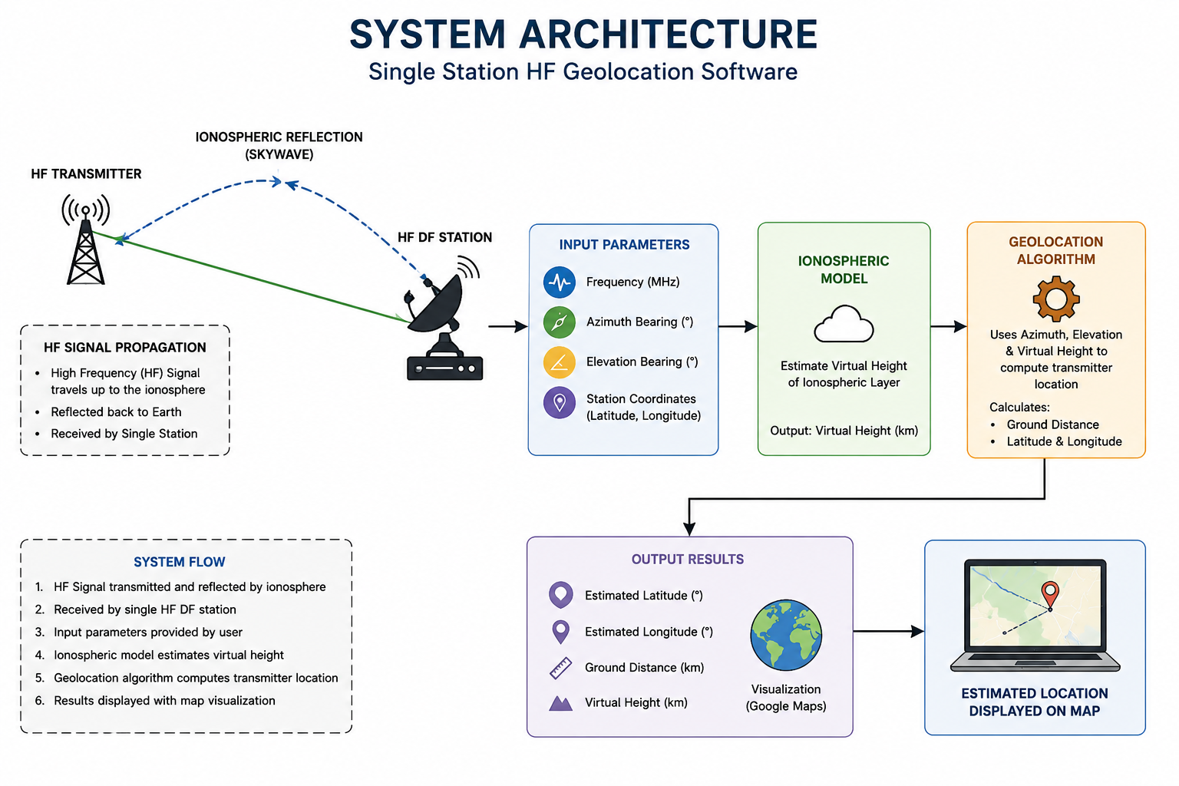
System Architecture

Slide 5
Methodology
Receive HF signal parameters.
Estimate virtual height using the ionospheric model.
Calculate ground distance.
Estimate transmitter coordinates.
Display the estimated location.
Open the location in Google Maps.

Slide 6
Software Implementation
Software Used
Python
Streamlit
Google Colab
VS Code
Modules
Input Module
Ionospheric Model
Geolocation Algorithm
Results & Visualization

Slide 7
Key Features
Single Station Geolocation
Virtual Height Estimation
Ground Distance Calculation
Latitude & Longitude Estimation
Interactive User Interface
Google Maps Integration
Fast Computation
Easy to Use

Slide 8
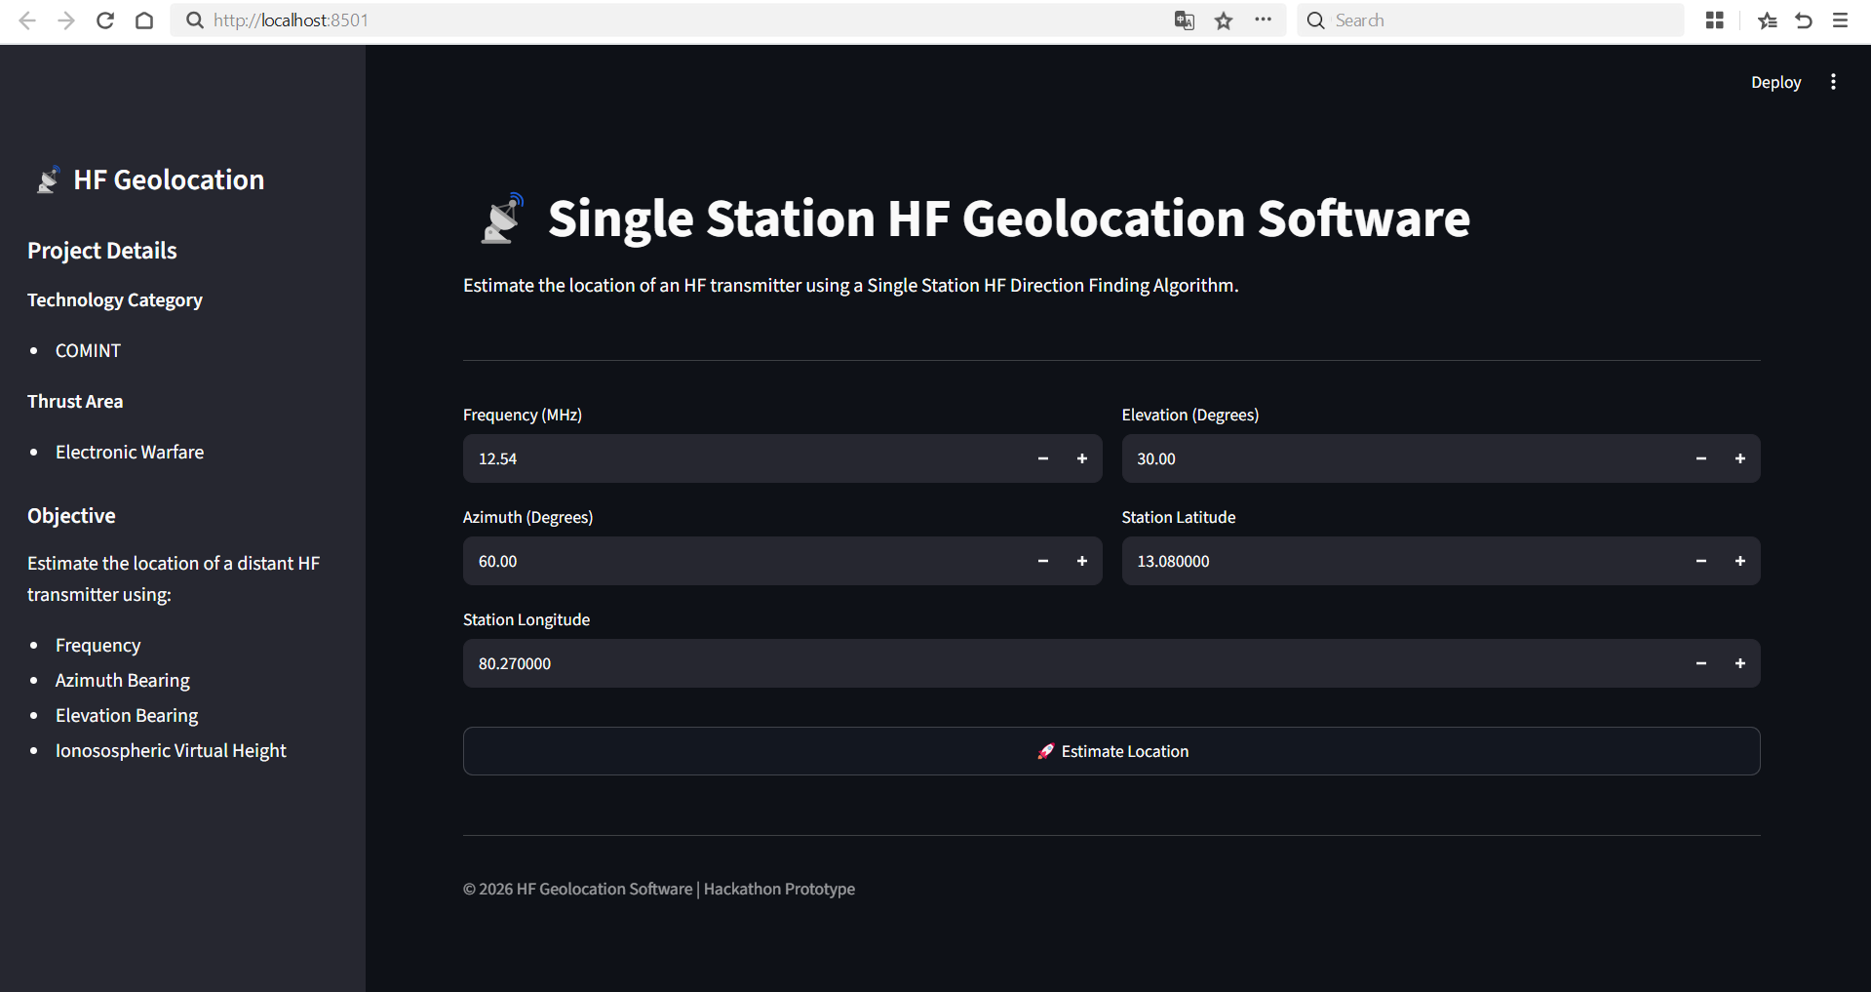
Outputs
Home screen and Input Section

Slide 9
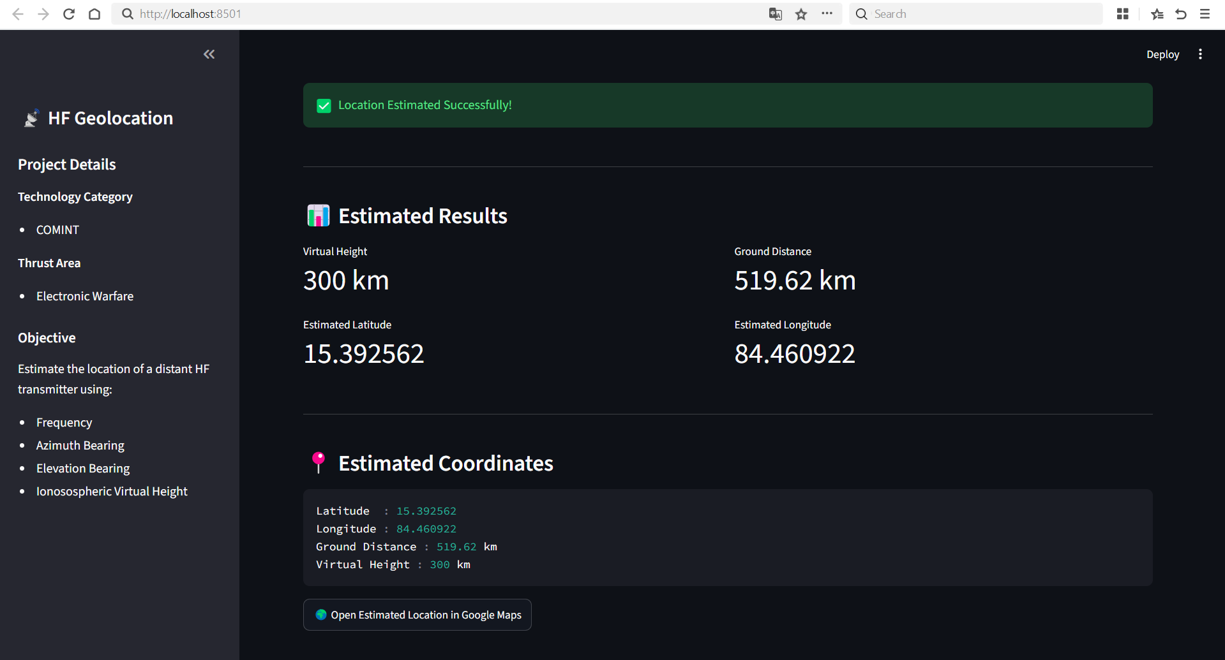
Results

Slide 10
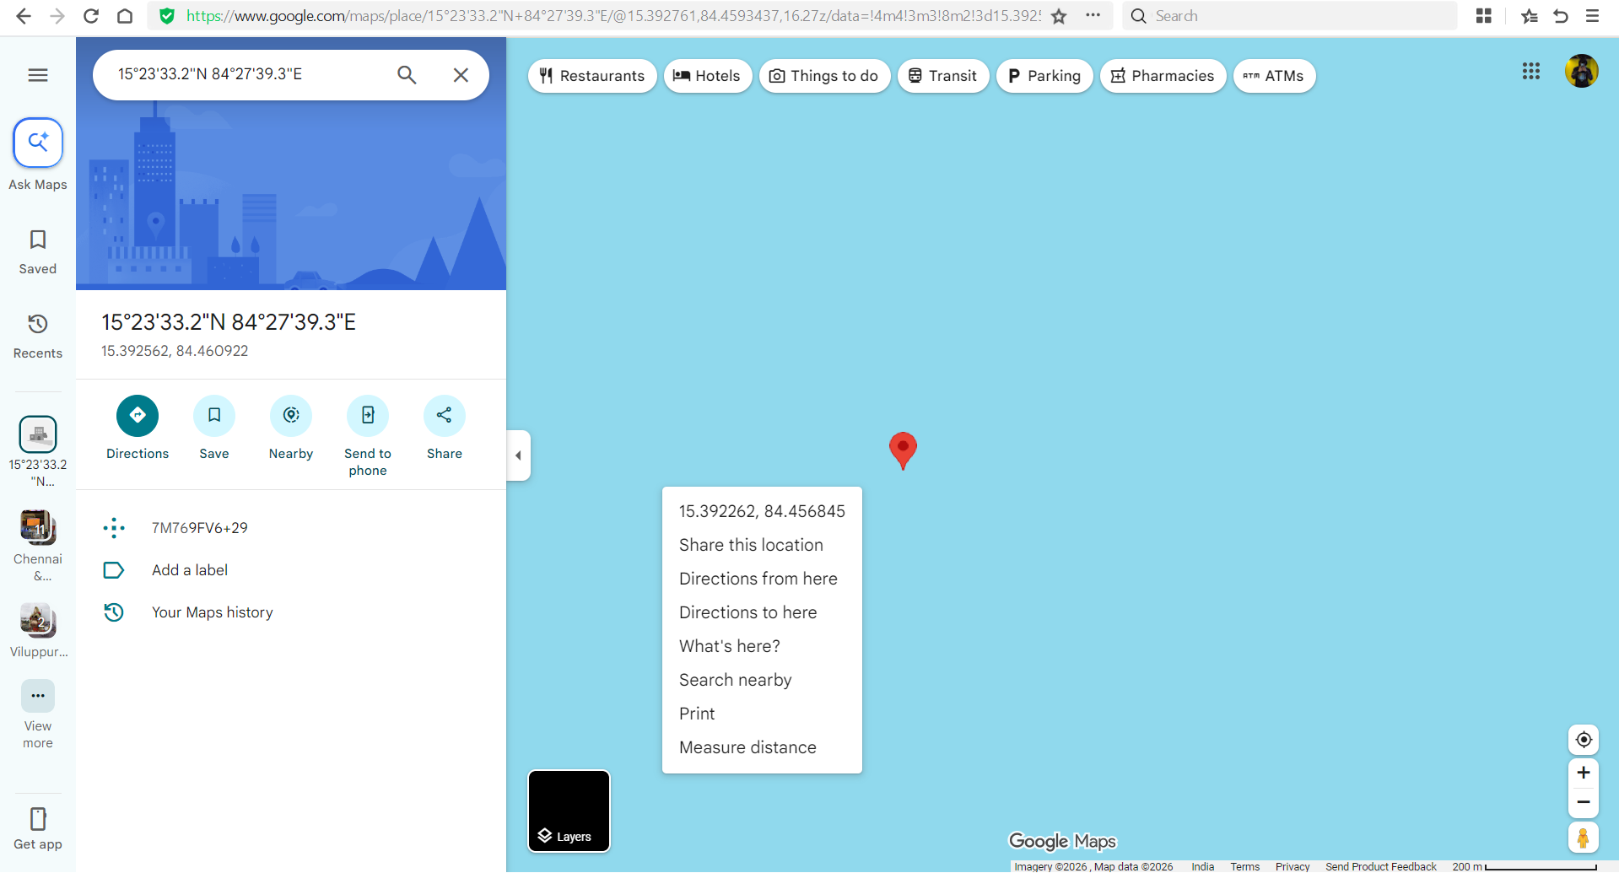
Google Maps page

Slide 11
Thank You

